Slide 1
SYSTEM and network SEcurity
By
Bernard S. Muwonge, Msc.DCSE
Intrusion detection

Slide 2
Intruders
Significant problem for networked systems is hostile or unwanted access
Either via local or remote users; or by software such as a virus, worm, or Trojan horse.
Can identify classes of intruders:
  Masquerader: An individual who is not authorized to use the computer (outsider)
  Misfeasor: A legitimate user who accesses unauthorized data, programs, or resources (insider)
  clandestine user: An individual who seizes supervisory control of the system and uses this control to evade auditing and access controls or to suppress audit collection (either)
Attacks range from benign (simply exploring net to see what is there); to the serious (attempt to read privileged data, perform unauthorized modifications, or disrupt system)
bmuwonge@cit.mak.ac.ug
MCN 7103 - System and Network Security
Notes:
A significant security problem for networked systems is hostile, or at least unwanted, trespass being unauthorized login or use of a system, by local or remote users; or by software such as a virus, worm, or Trojan horse.
One of the two most publicized threats to security is the intruder (or hacker or cracker), which Anderson identified three classes of:
• Masquerader: An individual who is not authorized to use the computer (outsider)
• Misfeasor: A legitimate user who accesses unauthorized data, programs, or resources (insider)
• Clandestine user: An individual who seizes supervisory control of the system and uses this control to evade auditing and access controls or to suppress audit collection (either)
Intruder attacks range from the benign (simply exploring net to see what is there); to the serious (who attempt to read privileged data, perform unauthorized modifications, or disrupt system)

Slide 3
Intruders
May seem benign, but still cost resources and may slow performance for legitimate users.
May use compromised system to launch other attacks on other systems, further degrading performance.
Awareness of intruders has led to the development of CERTs.
  These cooperative ventures collect information about system vulnerabilities and disseminate it to systems managers.
bmuwonge@cit.mak.ac.ug
MCN 7103 - System and Network Security
Notes:
The intruder threat has been well publicized, particularly because of the famous “Wily Hacker”incident of 1986–1987, documented by Cliff Stoll. Benign intruders might be tolerable, although they do consume resources and may slow performance for legitimate users. However, there is no way in advance to know whether an intruder will be benign or malign. Intruders may use compromised systems to launch attacks on other systems, further degrading performance.
One of the results of the growing awareness of the intruder problem has been the establishment of a number of computer emergency response teams (CERTs). These cooperative ventures collect information about system vulnerabilities and disseminate it to systems managers.

Slide 4
Intrusion Techniques
Objective of intruder is to gain access to a system or to increase the range of privileges accessible on a system.
Requires intruder to acquire information that should have been protected, e.g., a user password.
With knowledge of some other user's password, an intruder can log in to a system and exercise all the privileges accorded to the legitimate user.
bmuwonge@cit.mak.ac.ug
MCN 7103 - System and Network Security
Notes:
Knowing the standard attack methods is a key element in limiting your vulnerability. The basic aim is to gain access and/or increase privileges on some system. The basic attack methodology list is taken from McClure et al "Hacking Exposed".
A basic technique for gaining access is to acquire a user (preferably administrator) password, so the attacker can login and exercise all the access rights of the account owner.

Slide 5
Intrusion Techniques
System maintain a file that associates a password with each authorized user.
Password file can be protected with:
  One-way encryption:
    The system stores only the value of a function based on the user's password.
    When the user presents a password, the system transforms that password and compares it with the stored value.
  Access Control:
    Access to the password file is limited to one or a very few accounts.
bmuwonge@cit.mak.ac.ug
MCN 7103 - System and Network Security

Slide 6
Password Guessing
One of the most common attacks
attacker knows a login (from email/web page etc)
then attempts to guess password for it
  Try default passwords used with standard accounts that are shipped with the system. Many administrators don’t change these defaults.
  Exhaustively try all short passwords (those of one to three characters).
  Try words in the system's online dictionary or a list of likely passwords.
  Collect information about users, such as their full names, the names of their spouse and children, pictures in their office, and books in their office that are related to hobbies.
  Try users' phone numbers, Social Security numbers, and room numbers.
  Try all legitimate license plate numbers for this state.
bmuwonge@cit.mak.ac.ug
MCN 7103 - System and Network Security
Notes:
Password guessing is a common attack. If an attacker has obtained a poorly protected password file, then can mount attack off-line, so target is unaware of its progress. Some O/S take less care than others with their password files. If have to actually attempt to login to check guesses, then system should detect an abnormal number of failed logins, and hence trigger appropriate countermeasures by admins/security. Likelihood of success depends very much on how well the passwords are chosen. Unfortunately, users often don’t choose well (see later).

Slide 7
Password Capture
another attack involves password capture
  watching over shoulder as password is entered
  using a trojan horse program to collect
  monitoring an insecure network login
    eg. telnet, FTP, web, email
  extracting recorded info after successful login (web history/cache, last number dialed etc)
using valid login/password can impersonate user
users need to be educated to use suitable precautions/countermeasures
bmuwonge@cit.mak.ac.ug
MCN 7103 - System and Network Security
Notes:
There is also a range of ways of "capturing" a login/password pair, from the low-tech looking over the shoulder, to the use of Trojan Horse programs (eg. game program or nifty utility with a covert function as well as the overt behaviour), to sophisticated network monitoring tools, or extracting recorded info after a successful login - say from web history or cache, or last number dialed memory on phones etc. Need to educate users to be aware of whose around, to check they really are interacting with the computer system (trusted path), to beware of unknown source s/w, to use secure network connections (HTTPS, SSH, SSL), to flush browser/phone histories after use etc.

Slide 8
Intrusion Detection
Inevitably, the best system will have security failures
The intruder can be identified and ejected from the system.
An effective intrusion detection can prevent intrusions.
Intrusion detection enables the collection of information about intrusion techniques that can be used to strengthen the intrusion prevention facility.
bmuwonge@cit.mak.ac.ug
MCN 7103 - System and Network Security

Slide 9
Why Intrusion Detection?
There is need to detect intrusions because:
  If an intrusion is detected quickly enough, the intruder can be identified and ejected from the system before any damage is done or any data are compromised.
    The sooner the intrusion is detected, the less the amount of damage and the more quickly recovery can be achieved.
  An effective intrusion detection system can serve as a deterrent, so acting to prevent intrusions.
  Intrusion detection enables the collection of information about intrusion techniques that can be used to strengthen the intrusion prevention facility.
bmuwonge@cit.mak.ac.ug
MCN 7103 - System and Network Security
Notes:
Inevitably, the best intrusion prevention system will fail. A system’s second line of defense is intrusion detection, which aims to detect intrusions so can: block access & minimize damage if detected quickly; act as deterrent given chance of being caught; or can collect info on intruders to improve future security.
Intrusion detection is based on the assumption that the behavior of the intruder differs from that of a legitimate user in ways that can be quantified. This is imperfect at best.

Slide 10
Approaches to Intrusion Detection
Statistical anomaly detection:
  Involves the collection of data relating to the behavior of legitimate users over a period of time.
  Then statistical tests are applied to observed behavior to determine with a high level of confidence whether that behavior is not legitimate user behavior.
    Threshold detection: Involves defining thresholds, independent of user, for the frequency of occurrence of various events.
    Profile based: A profile of the activity of each user is developed and used to detect changes in the behavior of individual accounts.
bmuwonge@cit.mak.ac.ug
MCN 7103 - System and Network Security
Notes:
Can identify the following approaches to intrusion detection:
Statistical anomaly detection: collect data relating to the behavior of legitimate users, then use statistical tests to determine with a high level of confidence whether new behavior is legitimate user behavior or not.
a. Threshold detection: define thresholds, independent of user, for the frequency of occurrence of events.
b. Profile based: develop profile of activity of each user and use to detect changes in the behavior
2. Rule-based detection: attempt to define a set of rules used to decide if given behavior is an intruder
a. Anomaly detection: rules detect deviation from previous usage patterns
b. Penetration identification: expert system approach that searches for suspicious behavior

Slide 11
Rule-based detection:
  Involves an attempt to define a set of rules that can be used to decide that a given behavior is that of an intruder.
    Anomaly detection:
      Rules are developed to detect deviation from previous usage patterns.
    Penetration identification:
      An expert system approach that searches for suspicious behavior.
bmuwonge@cit.mak.ac.ug
MCN 7103 - System and Network Security

Slide 12
Audit Records
Fundamental tool for intrusion detection
Native audit records
    part of all common multi-user O/S for collecting info on user activity.
    Adv: no additional collection software is needed
    Disadv: may not have info wanted in desired form
Detection-specific audit records
    created specifically to collect info wanted by IDS.
    Adv: It can be vendor independent and portable
    Disadv: Cost of additional overhead on system due to two accounting packages running on a machine.
bmuwonge@cit.mak.ac.ug
MCN 7103 - System and Network Security
Notes:
A fundamental tool for intrusion detection is the audit record. Some record of ongoing activity by users must be maintained as input to an intrusion detection system. Basically,two plans are used:
• Native audit records: Virtually all main O/S’s include accounting software that collects information on user activity, advantage is its already there, disadvantage is it may not contain the needed information
• Detection-specific audit records: implement collection facility to generates custom audit records with desired info, advantage is it can be vendor independent and portable, disadvantage is extra overhead involved

Slide 13
Statistical Anomaly Detection
Threshold detection
    Count occurrences of specific event over time
    If exceed reasonable value assume intrusion
    Alone is a crude & ineffective detector of even moderately sophisticated attacks.
Profile based
    Characterize past behavior of users
    Detect significant deviations from this
    Profile usually multi-parameter, so that deviation on just a single parameter may not be sufficient in itself to signal an alert.
bmuwonge@cit.mak.ac.ug
MCN 7103 - System and Network Security
Notes:
Statistical anomaly detection techniques cover threshold detection and profile-based systems.
Threshold detection involves counting no occurrences of a specific event type over an interval of time, if count surpasses a reasonable number, then intrusion is assumed. By itself, is a crude and ineffective detector of even moderately sophisticated attacks.
Profile-based anomaly detection focuses on characterizing past behavior of users or groups, and then detecting significant deviations. A profile may consist of a set of parameters, so that deviation on just a single parameter may not be sufficient in itself to signal an alert. Foundation of this approach is analysis of audit records.

Slide 14
Audit Record Analysis
Foundation of statistical approaches
Analyze records to get metrics over time
  Counter(count of certain event types is kept over a period of time, e.g., number of logins by a single user in an hr, no. of password failures in a minute.),
  Gauge(used to measure current value of some entity, e.g., no. of logical connections assigned to a user application and the number of outgoing messages queued for a user process.)
  Interval timer(length of time between two related events, e.g., length of time between successive logins to an account.),
  Resource use(Quantity of resources consumed during a specified period, e.g., number of pages printed during a user session and total time consumed by a program execution.)
bmuwonge@cit.mak.ac.ug
MCN 7103 - System and Network Security
Notes:
An analysis of audit records over a period of time can be used to determine the activity profile of the average user. Then current audit records are used as input to detect intrusion, by analyzing incoming audit records to determine deviation from average behavior. Examples of metrics that are useful for profile-based intrusion detection are: counter, gauge, interval timer, resource use. Given these general metrics, various tests can be performed to determine whether current activity fits within acceptable limits, such as: Mean and standard deviation, Multivariate, Markov process, Time series, Operational; as discussed in the text.
Stallings Table18.1 shows various measures considered or tested for the Stanford Research Institute (SRI) intrusion detection system.
The main advantage of the use of statistical profiles is that a prior knowledge of security flaws is not required. Thus it should be readily portable among a variety of systems.

Slide 15
Given these metrics, use various tests on these to determine if current behavior is acceptable
  mean & standard deviation, multivariate, markov process, time series, operational
The main advantage of the use of statistical profiles is that a prior knowledge of security flaws is not required. The detector program learns what is "normal" behavior and then looks for deviations.
As an example of the use of these various metrics and models, the table below shows various measures considered or tested for the Stanford Research Institute (SRI) intrusion detection system (IDES) [DENN87, JAVI91, LUNT88].
bmuwonge@cit.mak.ac.ug
MCN 7103 - System and Network Security

Slide 16
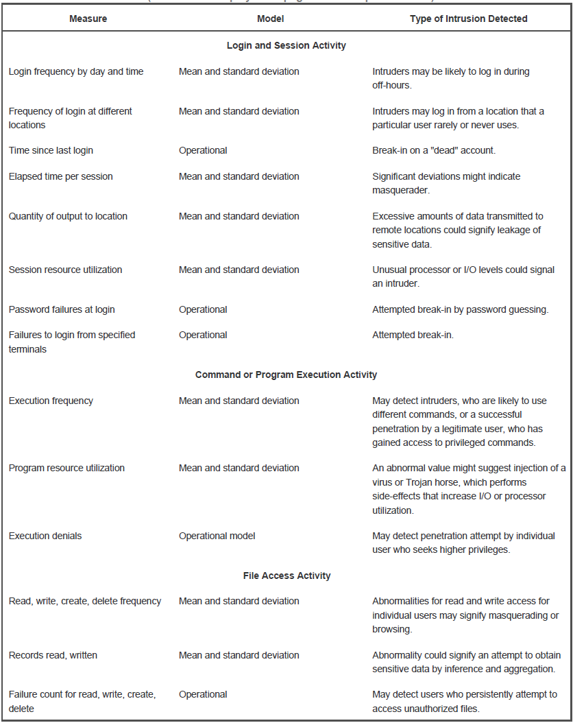

bmuwonge@cit.mak.ac.ug
MCN 7103 - System and Network Security

Slide 17
Rule-Based Intrusion Detection
observe events on system & apply rules to decide if activity is suspicious or not
rule-based anomaly detection
  analyze historical audit records to identify usage patterns & auto-generate rules for them
  then observe current behavior & match against rules to see if conforms
  like statistical anomaly detection does not require prior knowledge of security flaws
bmuwonge@cit.mak.ac.ug
MCN 7103 - System and Network Security
Notes:
Rule-based techniques detect intrusion by observing events in the system and applying a set of rules that lead to a decision regarding whether a given pattern of activity is or is not suspicious. Can characterize approaches as either anomaly detection or penetration identification, although there is overlap. Rule-based anomaly detection is similar in terms of its approach and strengths to statistical anomaly detection. Historical audit records are analyzed to identify usage patterns and to automatically generate rules that describe those patterns. Current behavior is then observed and matched against the set of rules to see if it conforms to any historically observed pattern of behavior. As with statistical anomaly detection, rule-based anomaly detection does not require knowledge of security vulnerabilities within the system.

Slide 18
Rule-Based Intrusion Detection
Rule-based penetration identification
  uses expert systems technology
  with rules identifying known penetration, weakness patterns, or suspicious behavior
  compare audit records or states against rules
  rules usually machine & O/S specific
  rules are generated by experts who interview & codify knowledge of security admins
  quality depends on how well this is done
bmuwonge@cit.mak.ac.ug
MCN 7103 - System and Network Security
Notes:
Rule-based penetration identification takes a very different approach based on expert system technology. It uses rules for identifying known penetrations or penetrations that would exploit known weaknesses, or identify suspicious behavior. The rules used are specific to machine and operating system. The rules are generated by “experts”, from interviews of system administrators and security analysts. Thus the strength of the approach depends on the skill of those involved in setting up the rules.

Slide 19
Base-Rate Fallacy
practically an intrusion detection system needs to detect a substantial percentage of intrusions with few false alarms
  if too few intrusions detected -> false security
  if too many false alarms -> ignore / waste time
this is very hard to do
existing systems seem not to have a good record
bmuwonge@cit.mak.ac.ug
MCN 7103 - System and Network Security
Notes:
To be of practical use, an intrusion detection system should detect a substantial percentage of intrusions while keeping the false alarm rate at an acceptable level. If only a modest percentage of actual intrusions are detected, the system provides a false sense of security. On the other hand, if the system frequently triggers an alert when there is no intrusion (a false alarm), then either system managers will begin to ignore the alarms, or much time will be wasted analyzing the false alarms. Unfortunately, because of the nature of the probabilities involved, it is very difficult to meet the standard of high rate of detections with a low rate of false alarms. A study of existing intrusion detection systems indicated that current systems have not overcome the problem of the base-rate fallacy.

Slide 20
Distributed Intrusion Detection
Traditional focus is on single systems
But typically have networked systems
More effective defense has these working together to detect intrusions
Issues
  dealing with varying audit record formats
  integrity & confidentiality of networked data
  centralized or decentralized architecture
bmuwonge@cit.mak.ac.ug
MCN 7103 - System and Network Security
Notes:
Until recently, work on intrusion detection systems focused on single-system standalone facilities. The typical organization, however, needs to defend a distributed collection of hosts supported by a LAN or internetwork, where a more effective defense can be achieved by coordination and cooperation among intrusion detection systems across the network.
Porras points out the following major issues in the design of a distributed IDS:
• A distributed intrusion detection system may need to deal with different audit record formats
• One or more nodes in the network will serve as collection and analysis points for the data, which must be securely transmitted to them
• Either a centralized (single point, easier but bottleneck) or decentralized (multiple centers must coordinate) architecture can be used.

Slide 21
Distributed Intrusion Detection – Architecture
Fig.2 shows the overall architecture, consisting of three main components, of the system independent distributed IDS developed at the University of California at Davis.
The components are:
  Host agent module: audit collection module operating as a background process on a monitored system. Collects data on security-related events on the host and transmit these to the central manager.
  LAN monitor agent module: like a host agent module except it analyzes LAN traffic, & reports results to central manager.
  Central manager module: Receives reports from LAN monitor and host agents and processes and correlates these reports to detect intrusion.
bmuwonge@cit.mak.ac.ug
MCN 7103 - System and Network Security

Slide 22
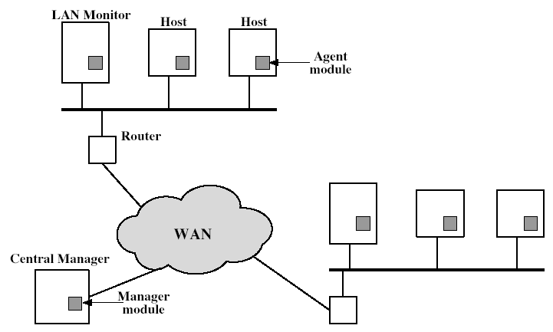
Distributed Intrusion Detection - Architecture
bmuwonge@cit.mak.ac.ug
MCN 7103 - System and Network Security
Notes:
Stallings Figure18.2 shows the overall architecture, consisting of three main components, of the system independent distributed IDS developed at the University of California at Davis. The components are:
• Host agent module: audit collection module operating as a background process on a monitored system
• LAN monitor agent module: like a host agent module except it analyzes LAN traffic
• Central manager module: Receives reports from LAN monitor and host agents and processes and correlates these reports to detect intrusion

Slide 23
Distributed Intrusion Detection – Agent Implementation
The agent captures each native O/S audit record, & applies a filter that retains only records of security interest.
These records are then reformatted into a standardized format (HAR).
Then a template-driven logic module analyzes the records for suspicious activity.
When suspicious activity is detected, an alert is sent to the central manager.
The central manager includes an expert system that can draw inferences from received data.
bmuwonge@cit.mak.ac.ug
MCN 7103 - System and Network Security

Slide 24
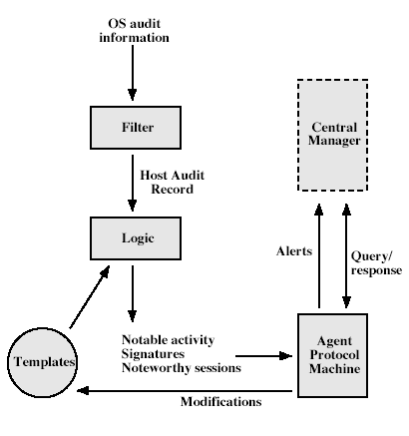
Distributed Intrusion Detection – Agent Implementation
bmuwonge@cit.mak.ac.ug
MCN 7103 - System and Network Security
Notes:
Stallings Figure 18.3 shows the general approach that is taken. The agent captures each native O/S audit record, & applies a filter that retains only records of security interest. These records are then reformatted into a standardized format (HAR). Then a template-driven logic module analyzes the records for suspicious activity. When suspicious activity is detected, an alert is sent to the central manager. The central manager includes an expert system that can draw inferences from received data. The manager may also query individual systems for copies of HARs to correlate with those from other agents.

Slide 25
Honey pots
Are decoy systems designed to lure attackers
    away from accessing critical systems
    to collect information of their activities
    to encourage attacker to stay on system long enough so administrator can respond
Are filled with fabricated information designed to appear valuable but which any legitimate user of the system wouldn’t access, thus, any access is suspect.
Instrumented with sensitive monitors and event loggers that detect these accesses and to collect detailed information on attackers’ activities.
Single or multiple networked systems
bmuwonge@cit.mak.ac.ug
MCN 7103 - System and Network Security
Notes:
Honeypots are decoy systems, designed to lure a potential attacker away from critical systems, and:
• divert an attacker from accessing critical systems
• collect information about the attacker’s activity
• encourage the attacker to stay on the system long enough for administrators to respond
These systems are filled with fabricated information designed to appear valuable but which any legitimate user of the system wouldn’t access, thus, any access is suspect.
They are instrumented with sensitive monitors and event loggers that detect these accesses and collect information about the attacker’s activities.
Have seen evolution from single host honeypots to honeynets of multiple dispersed systems.
The IETF Intrusion Detection Working Group is currently drafting standards to support interoperability of IDS info (both honeypot and normal IDS) over a wide range of systems & O/S’s.

Slide 26
Password Management
Front-line defense against intruders
Users supply both:
    Login ID – determines privileges of that user
    password – to authenticate the user’s ID
Passwords often stored encrypted
    Unix uses multiple DES (variant with a one-way hash function)
    more recent systems use crypto hash function (e.g., MD5)
Should protect password file on system to make guessing attacks harder.
bmuwonge@cit.mak.ac.ug
MCN 7103 - System and Network Security
Notes:
The front line of defense against intruders is the password system, where a user provides a name/login identifier (ID) and a password. The password serves to authenticate the ID of the individual logging on to the system. Passwords are usually stored encrypted rather than in the clear (which would make them more vulnerable to theft). Unix systems traditionally used a multiple DES variant with salt as a one-way hash function (see text). More recent O/S’s use a cryptographic hash function (eg. MD5). The file containing these passwords hashes needs access control protections to make guessing attacks harder.

Slide 27
Password Studies
Purdue 1992 –
  many short passwords:
  observed password change choices on 54 machines, for 7000 users, and found almost 3% of the passwords were three characters or fewer in length
Klein 1990 - many guessable passwords
conclusion is that users choose poor passwords too often
need some approach to counter this
bmuwonge@cit.mak.ac.ug
MCN 7103 - System and Network Security
Notes:
Studies have shown that users tend to choose poor passwords too often.
A study at Purdue University in 1992 observed password change choices on 54 machines, for 7000 users, and found almost 3% of the passwords were three characters or fewer in length, easily exhaustively searched!
Password length is only part of the problem, since many people pick a password that is guessable, such as their own name, their street name, a common dictionary word, and so forth. This makes the job of password cracking straightforward.
A study by Klein 1990 collected UNIX password files, containing nearly 14,000 encrypted passwords, and found nearly one-fourth of these passwords were guessable.
A strategy is needed to force users to select passwords that are difficult to guess.

Slide 28
Managing Passwords - Education
Can use policies and good user education
Educate on importance of good passwords
Give guidelines for good passwords
  minimum length (>6)
  require a mix of upper & lower case letters, numbers, punctuation
  not dictionary words
But likely to be ignored by many users
bmuwonge@cit.mak.ac.ug
MCN 7103 - System and Network Security
Notes:
Goal is to eliminate guessable passwords while allowing user to select a memorable password. Four basic techniques are in use: education, computer generation, reactive checking & proactive checking.
The user education strategy tells users the importance of using hard-to-guess passwords and provides guidelines for selecting strong passwords, but it needs their cooperation. The problem is that many users will simply ignore the guidelines.

Slide 29
Managing Passwords - Computer Generated
Let computer create passwords for users
If random likely not memorisable, so will be written down (sticky label syndrome)
even pronounceable not remembered
have history of poor user acceptance
FIPS PUB 181 one of best generators
  has both description & sample code
  generates words from concatenating random pronounceable syllables
bmuwonge@cit.mak.ac.ug
MCN 7103 - System and Network Security
Notes:
Computer-generated passwords create a password for the user, but have problems. If the passwords are quite random in nature, users will not be able to remember them. Even if the password is pronounceable, the user may have difficulty remembering it and so be tempted to write it down. In general, computer-generated password schemes have a history of poor acceptance by users. FIPS PUB 181 defines one of the best-designed automated password generators. The standard includes not only a description of the approach but also a complete listing of the C source code of the algorithm, which generates words by forming a random set of pronounceable syllables and concatenating them to form a word.

Slide 30
Managing Passwords - Reactive Checking
system periodically runs its own password cracker to find guessable passwords.
The system cancels any passwords that are guessed and notifies the user.
but is resource intensive
bad passwords are vulnerable till found
bmuwonge@cit.mak.ac.ug
MCN 7103 - System and Network Security
Notes:
A reactive password checking strategy is one in which the system periodically runs its own password cracker to find guessable passwords. The system cancels any passwords that are guessed and notifies the user. Drawbacks are that it is resource intensive if the job is done right, and any existing passwords remain vulnerable until the reactive password checker finds them.

Slide 31
Managing Passwords - Proactive Checking
Most promising approach to improving password security
Allow users to select own password.
Need to strike a balance between user acceptability and strength.
Have system verify it is acceptable
  simple rule enforcement.
  compare against dictionary of bad passwords
  use algorithmic (markov model or bloom filter) to detect poor choices
bmuwonge@cit.mak.ac.ug
MCN 7103 - System and Network Security
Notes:
The most promising approach to improved password security is a proactive password checker, where a user is allowed to select his or her own password, but the system checks to see if it is allowable and rejects it if not. The trick is to strike a balance between user acceptability and strength.
The first approach is a simple system for rule enforcement, enforcing say guidelines from user education. May not be good enough. Another approach is to compile a large dictionary of possible “bad”passwords, and check user passwords against this disapproved list. But this can be very large & slow to search. A third approach is based on rejecting words using either a Markov model of guessable passwords, or a Bloom filter. Both attempt to identify good or bad passwords without keeping large dictionaries. See text for details.

Slide 32
Physical Security
Mentality “firewalls fix everything”
More than 50% of security breaches come from inside
Types of Harm
  Server compromise
  Network infrastructure compromise
  Workstation compromise (Trojans)
  Loss or theft of proprietary data
  Transmission of inaccurate data
  Denial of Service
bmuwonge@cit.mak.ac.ug
MCN 7103 - System and Network Security

Slide 33
The Human Dimension
Dimension: least risk to most
    Members of public
    Temporary employees
    Departmental users
    Infrastructure
    Server
    Administrators
Scofflaw employees – that want to bypass security rules for their convenience, e.g., installing own modem
IT employees: logic bomb
bmuwonge@cit.mak.ac.ug
MCN 7103 - System and Network Security

Slide 34
Physical Security: “Do”s
Do: lock wiring closets
Do: use switches rather than hubs (esp. for admins)
Do: change locks immediately when employee leaves
Do: erase hard drives when you take them out of service
Do: lock the server cabinets
Do: restrict or forbid the use of modems on desktops
Do: make sure road laptops and PDAs are secure
Do: consider use of smart-cards rather than passwords for administrators
bmuwonge@cit.mak.ac.ug
MCN 7103 - System and Network Security

Slide 35
Physical Security: “Don’t”s
Don’t: send off-site backups to unsecured sites
Don’t: give keys to vendors
Don’t: allow adhoc access to data center
Don’t: share wire closets with printers etc.
Don’t: put servers in unsecured areas
Don’t: leave server keys on back on server
Don’t: let cleaning people in without escort
Don’t: store sensitive data on user drives (or encrypt)
Don’t: discuss passwords over non-secure channels
Don’t: put consoles near windows
bmuwonge@cit.mak.ac.ug
MCN 7103 - System and Network Security

Slide 36
References and recommended reading
Comer, D. Internetworking with TCP/IP, Volume I: Principles, Protocols and Architecture. Prentic Hall, 1995
Stevens, W. TCP/IP Illustrated, Volume 1: The Protocols. Addison-Wesley, 1994
bmuwonge@cit.mak.ac.ug
MCN 7103 - System and Network Security
Notes:
CS 543 - Data Warehousing (Sp 2005-2006) - Asim Karim @ LUMS

